Slide 1
JULY, 2018
ENVIRONMENTAL
CHEMISTRY
By: Eng Kaela Kamweneshe
_{+260978681285/+260955085692}
_{kamweneshek@gmail.com}

Slide 2
Course Outline:
WEEK 1:
TOPIC 1: CHAPTER 1: INTRODUCTION TO ENVIRONMENTAL CHEMISTRY 1 Chemistry and Environmental Chemistry 2 The Building Blocks of Matter 3 Chemical Bonds, Compound Formation and Octet Rule
WEEK 2:
TOPIC 2: CHAPTER 2: ACIDS, BASES, AND SALTS 1 The Importance and nature of Acids, Bases, and Salts 2 Dissociation of Acids and Bases in Water 3 pH and the Relationship Between Hydrogen Ion and Hydroxide Ion Concentrations 4 Preparation of Acids, Bases and Salts
WEEK 3:
TOPIC 3: CHAPTER 3: SOLUTIONS 1 The Solution Process, Solubility and Concentration 2 Standard Solutions and Titrations 3 Solution Equilibria 4 Colloidal Suspensions Onlines Sources

Slide 3
Course Outline : contn.
WEEK 4:
TOPIC: 4)CHAPTER 4: ENVIRONMENTAL CHEMISTRY OF WATER 1 Aquatic Chemistry 2 Metal Ions and Calcium in Water 3 Oxidation-Reduction - Complexation and Chelation and Water Interactions with Other Phases
WEEK 5:
TOPIC 5: CHAPTER 5: WATER POLLUTION 1 Nature and Types of Water Pollutants 2 Elemental Pollutants, Heavy Metal, Metalloid 3 Organically Bound Metals and Metalloids
WEEK 6:
TOPIC 6: CHAPTER 5: WATER POLLUTION 4 Inorganic Species 5 Oxygen, Oxidants, and Reductants 6 Organic Pollutants, Pesticides in Water and Polychlorinated Biphenyls

Slide 4
Course Outline : contn.
WEEK 7:
TOPIC 6: CHAPTER 6: THE ATMOSPHERE AND ATMOSPHERIC CHEMISTRY 1 The Atmosphere and Atmospheric Chemistry 2 Physical Characteristics of the Atmosphere 3 Energy Transfer in the Atmosphere 4 Atmospheric Mass Transfer, Meteorology, and Weather
WEEK 8 :
TOPIC 6: CHAPTER 6: THE ATMOSPHERE AND ATMOSPHERIC CHEMISTRY
5 Inversions and Air Pollution 6 Chemical and Photochemical Reactions in the Atmosphere 7 Acid–Base Reactions in the Atmosphere 8 Reactions of Atmospheric Oxygen and Nitrogen

Slide 5
Course Outline : contn.
WEEK 9:
TOPIC: CHAPTER 7: SOIL ENVIRONMENTAL CHEMISTRY 1 Nature and Composition of Soil 2 Acid-Base and Ion Exchange Reactions in Soils 3 Macronutrients and Micronutrients in Soil
WEEK 10:
TOPIC: CHAPTER 7: SOIL ENVIRONMENTAL CHEMISTRY 4 Fertilizers 5 Wastes and Pollutants in Soil 6 Soil Loss and Degradation

Slide 6
CHAPTER 1 INTRODUCTION TO CHEMISTRY
1.1 Chemistry and Environmental Chemistry
1.2 A Mini-Course in Chemistry
1.3 The Building Blocks of Matter
1.4 Chemical Bonds and Compounds
1.5 Chemical Reactions and Equations
1.6 Numbers in Chemistry: Exponential notation
1.7 Significant Figures and Uncertainties in Numbers
1.8 Measurement and Systems of Measurement
1.9 Units of Mass
1.10 Units of Length
1.11 Units of Volume
1.12 Temperature, Heat, and Energy
1.13 Pressure
1.14 Units and Their Use in Calculations
Chapter Summary

Slide 7
1.1 Chemistry and Environmental Chemistry
Chemistry is defined as the science of matter.
Therefore, it deals with the air we breathe, the water we drink, the soil that grows our food, and vital life substances and processes.
Our own bodies contain a vast variety of chemical substances and are tremendously sophisticated chemical factories that carry out an incredible number of complex chemical processes.
There is a tremendous concern today about the uses—and particularly the misuses— of chemistry as it relates to the environment.
Ongoing events serve as constant reminders of threats to the environment ranging from individual exposures to toxicants to phenomena on a global scale that may cause massive, perhaps catastrophic, alterations in climate.
These include, as examples, evidence of a perceptible warming of climate; record weather events—particularly floods—in the United States in the 1990s; and air quality in Mexico City so bad that it threatens human health.
Furthermore, large numbers of employees must deal with hazardous substances and wastes in laboratories and the workplace.
All such matters involve environmental chemistry for understanding of the problems and for arriving at solutions to them.

Slide 8
Environmental chemistry
Environmental chemistry is that branch of chemistry that deals with the origins, transport, reactions, effects, and fates of chemical species in the water, air, earth, and living environments and the influence of human activities thereon.1
A related discipline, toxicological chemistry, is the chemistry of toxic substances with emphasis upon their interaction with biologic tissue and living systems.
Besides its being an essential, vital discipline in its own right, environmental chemistry provides an excellent framework for the study of chemistry, dealing with “general chemistry,” organic chemistry, chemical analysis, physical chemistry, photochemistry, geochemistry, and biological chemistry.
By necessity it breaks down the barriers that tend to compartmentalize chemistry as it is conventionally addressed.
Therefore, this book is written with two major goals—to provide an overview of chemical science within an environmental chemistry framework and to provide the basics of environmental.
Chemistry for those who need to know about this essential topic for their professions or for their overall education.

Slide 9
1.2 A MINI-COURSE IN CHEMISTRY
It is much easier to learn chemistry if one already knows some chemistry!
That is, in order to go into any detail on any chemical topic, it is extremely helpful to have some very rudimentary knowledge of chemistry as a whole.
For example, a crucial part of chemistry is an understanding of the nature of chemical compounds, the chemical formulas used to describe them, and the chemical bonds that hold them together; these are topics addressed in Chapter 3 of this book.
However, to understand these concepts, it is very helpful to know some things about the chemical reactions by which chemical compounds are formed, as addressed in Chapter 4.
To work around this problem, Chapter 1 provides a highly condensed, simplified, but meaningful overview of chemistry to give the reader the essential concepts and terms required to understand more-advanced chemical material.

Slide 10
1.3 THE BUILDING BLOCKS OF MATTER
All matter is composed of only about a hundred (100) fundamental kinds of matter called elements.
Each element is made up of very small entities called atoms; all atoms of the same element behave identically chemically.
The study of chemistry, therefore, can logically begin with elements and the atoms of which they are composed.

Slide 11
Subatomic Particles and Atoms
Figure below, represents an atom of deuterium, a form of the element hydrogen.
It is seen that such an atom is made up of even smaller subatomic particles—positively charged protons, negatively charged electrons, and uncharged (neutral) neutrons.
Protons and neutrons have relatively high masses compared with electrons and are contained in the positively charged nucleus of the atom.
The nucleus has essentially all the mass, but occupies virtually none of the volume, of the atom.
An uncharged atom has the same number of electrons as protons.
The electrons in an atom are contained in a cloud of negative charge around the nucleus that occupies most of the volume of the atom.

Slide 12
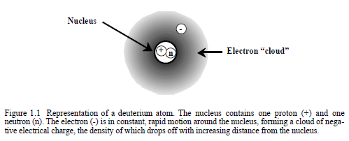
Atom of Deuterium (H)

Slide 13
Atoms and Elements
All of the literally millions of different substances are composed of only around 100 elements.
Each atom of a particular element is chemically identical to every other atom and contains the same number of protons in its nucleus.
This number of protons in the nucleus of each atom of an element is the atomic number of the element.
Atomic numbers are integers ranging from 1 to more than 100, each of which denotes a particular element.
In addition to atomic numbers, each element has a name and a chemical symbol, such as carbon, C; potassium, K (for its Latin name kalium); or cadmium, Cd.
In addition to atomic number, name, and chemical symbol, each element has an atomic mass (atomic weight).
The atomic mass of each element is the average mass of all atoms of the element, including the various isotopes of which it consists.
The atomic mass unit, u (also called the dalton), is used to express masses of individual atoms and molecules (aggregates of atoms).
These terms are summarized in Figure below.

Slide 14
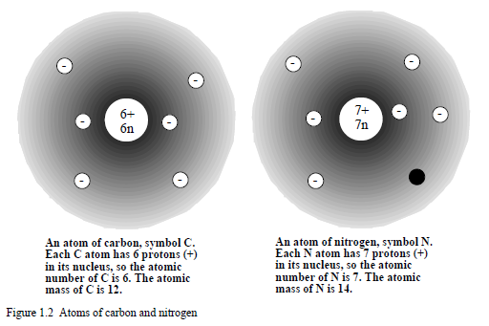
Carbon Isotope

Slide 15
.
Although atoms of the same element are chemically identical, atoms of most elements consist of two or more isotopes that have different numbers of neutrons in their nuclei.
Some isotopes are radioactive isotopes or radionuclides, which have unstable nuclei that give off charged particles and gamma rays in the form of radioactivity.
This process of radioactive decay changes atoms of a particular element to atoms of another element.
Throughout this book reference is made to various elements.
Fortunately, most of the chemistry covered in this lesson requires familiarity with only about 25 or 30 elements.
An abbreviated list of a few of the most important elements that the reader should learn at this point is given in Table below

Slide 16
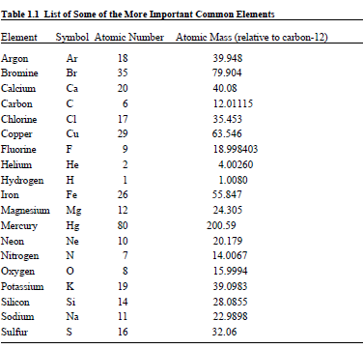
List Of Some Important Elements

Slide 17
The Periodic Table
When elements are considered in order of increasing atomic number, it is
observed that their properties are repeated in a periodic manner.
For example, elements with atomic numbers 2, 10, and 18 are gases that do not undergo chemical reactions and consist of individual molecules, whereas those with atomic numbers larger by one—3, 11, and 19—are unstable, highly reactive metals.
An arrangement of the elements in a manner that reflects this recurring behavior is known as the periodic table (Figure 1.3).
The periodic table is extremely useful in understanding chemistry and predicting chemical behavior.
The entry for each element in the periodic table gives the element’s atomic number, name, symbol, and atomic mass.
More-detailed versions of the table include other information as well.

Slide 18
.
The periodic table gets its name from the fact that the properties of elements are repeated periodically in going from left to right across a horizontal row of elements.
The table is arranged such that an element has properties similar to those of other elements above or below it in the table.
Elements with similar chemical properties are called groups of elements and are contained in vertical columns in the periodic table.

Slide 19
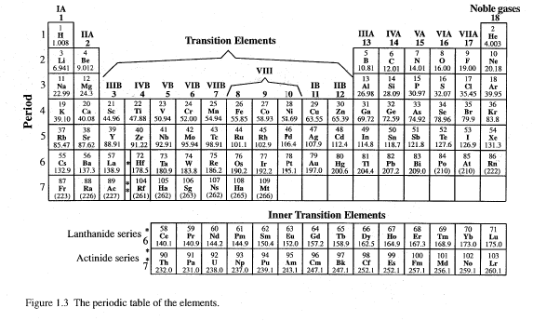
Periotic Table of Elements

Slide 20
1.4. CHEMICAL BONDS AND COMPOUNDS
Only a few elements, particularly the noble gases, exist as individual atoms; most atoms are joined by chemical bonds to other atoms.
This can be illustrated very simply by elemental hydrogen, which exists as molecules, each consisting of 2 H atoms linked by a chemical bond as shown in Figure below.
Because hydrogen molecules contain 2 H atoms, they are said to be diatomic and are denoted by the chemical formula H₂.
The H atoms in the H₂ molecule are held together by a covalent bond made up of 2 electrons, each contributed by one of the H atoms, and shared between the atoms.

Slide 21
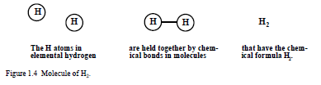
Hydrogen Bonds

Slide 22
.
Chemical Compounds
Most substances consist of two or more elements joined by chemical bonds.
As an example, consider the chemical combination of the elements hydrogen and oxygen shown in Figure 1.5.
Oxygen, chemical symbol O, has an atomic number of 8 and an atomic mass of 16.00 and exists in the elemental form as diatomic molecules of O2.
Hydrogen atoms combine with oxygen atoms to form molecules in which 2 H atoms are bonded to 1 O atom in a substance with a chemical formula of H2O (water).
A substance such as H2O that consists of a chemically bonded combination of two or more elements is called a chemical compound.
(A chemical compound is a substance that consists of atoms of two or more different elements bonded together.)

Slide 23
Chemical Compounds
In the chemical formula for water the letters H and O are the chemical symbols of the two elements in the compound and the subscript 2 indicates that there are 2 H atoms per O atom.
(The absence of a subscript after the O denotes the presence of just 1 O atom in the molecule.)
Each of the chemical bonds holding a hydrogen atom to the oxygen atom in the water molecule is composed of two electrons shared between the hydrogen and oxygen atoms.

Slide 24
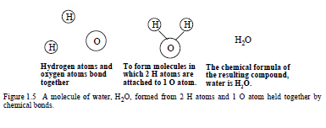
Chemical compounds

Slide 25
Ionic Bonds
As shown in Figure 1.6, the transfer of electrons from one atom to another produces charged species called ions.
Positively charged ions are called cations and negatively charged ions are called anions.
Ions that make up a solid compound are held together by ionic bonds in a crystalline lattice consisting of an ordered arrangement of the ions in which each cation is largely surrounded by anions and each anion by cations.
The attracting forces of the oppositely charged ions in the crystalline lattice constitute the ionic bonds in the compound.
The formation of the ionic compound magnesium oxide is shown in Figure 1.6.
In naming this compound, the cation is simply given the name of the element from which it was formed, magnesium. However, the ending of the name of the anion, oxide, is different from that of the element from which it was formed, oxygen.

Slide 26
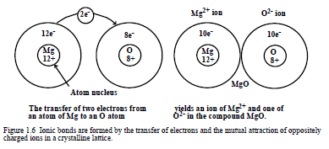
Ionic Bonds

Slide 27

.
Rather than individual atoms that have lost or gained electrons, many ions are
groups of atoms bonded together covalently and having a net charge.
A common example of such an ion is the ammonium ion, NH₄⁻ .
Ammonium ion, NH₄ ⁻ consisting of 4 hydrogen atoms covalently bonded to a single nitrogen (N) atom and having a net electrical charge of +1 for the whole cation.

Slide 28
Summary of Chemical Compounds and the Ionic Bond
The preceding several pages have just covered some material on chemical compounds and bonds that are essential to understand chemistry.
To summarize, these are the following:
Atoms of two or more different elements can form chemical bonds with each other to yield a product that is entirely different from the elements.
Such a substance is called a chemical compound.
The formula of a chemical compound gives the symbols of the elements and uses subscripts to show the relative numbers of atoms of each element in the compound.
Molecules of some compounds are held together by covalent bonds consisting of shared electrons.
Another kind of compound consists of ions composed of electrically charged atoms or groups of atoms held together by ionic bonds that exist because of the mutual attraction of oppositely charged ions.

Slide 29
Molecular Mass
The average mass of all molecules of a compound is its molecular mass (formerly called molecular weight).
The molecular mass of a compound is calculated by multiplying the atomic mass of each element by the relative number of atoms of the element, then adding all the values obtained for each element in the compound.
For example, the molecular mass of NH3 is 14.0 + 3 x 1.0 = 17.0.
As another example consider the following calculation of the molecular mass of ethylene, C₂H₄.
1. The chemical formula of the compound is C₂H₄.
2. Each molecule of C2H4 consists of 2 C atoms and 4 H atoms.
3. From the periodic table , the atomic mass of C is 12.0 and that of H is 1.0.
4. Therefore, the molecular mass of C₂H₄ is
12.0 + 12.0 + 1.0 + 1.0 + 1.0 + 1.0 = 28.0
From 2 C atoms From 4 H atoms

Slide 30
CHEMICAL REACTIONS AND EQUATIONS
Chemical reactions occur when substances are changed to other substances through the breaking and formation of chemical bonds.
For example, water is produced by the chemical reaction of hydrogen and oxygen:
Hydrogen plus oxygen yields water

Slide 31
.
Chemical reactions are written as chemical equations.
2H₂ + O₂ → 2H₂O
The chemical reaction between hydrogen and water is written as the balanced chemical equation in which the arrow is read as “yields” and separates the hydrogen and oxygen reactants from the water product.
Note that because elemental hydrogen and elemental oxygen occur as diatomic molecules of H₂ and O₂, respectively, it is necessary to write the equation in a way that reflects these correct chemical formulas
of the elemental form.
All correctly written chemical equations are balanced, in that they must show the same number of each kind of atom on both sides of the equation.
The equation above is balanced because of the following:

Slide 32
.
On the left
There are 2 H₂ molecules, each containing 2 H atoms for a total of 4 H atoms on the left.
There is 1 O₂ molecule, containing 2 O atoms for a total of 2 O atoms on the left.
On the right
There are 2 H2O molecules each containing 2 H atoms and 1 O atom for a total of 4 H atoms and 2 O atoms on the right.
The process of balancing chemical equations is relatively straightforward for simple equations.

Slide 33
NUMBERS IN CHEMISTRY: EXPONENTIAL NOTATION
An essential skill in chemistry is the ability to handle numbers, including very large and very small numbers.
Avogadro’s number is a way of expressing quantities of entities such as atoms or molecules and is equal to 602,000,000,000,000,000,000,000.
A number so large written in this decimal form is very cumbersome to express and very difficult to handle in calculations.
It can be expressed much more conveniently in exponential notation. Avogadro’s number in exponential notation is 6.02 x 10²³.
It is put into decimal form by moving the decimal in 6.02 to the right by 23 places.

Slide 34
.
Exponential notation works equally well to express very small numbers, such as 0.000,000,000,000,000,087.
In exponential notation this number is 8.7 x 10⁻¹⁷.
To convert this number back to decimal form, the decimal point, is simply moved 17 places to the left.
A number in exponential notation consists of a digital number equal to or greater than exactly 1 and less than exactly 10 (examples are 1.00000, 4.3, 6.913, 8.005, 9.99999) multiplied by a power of 10 (10⁻¹⁷, 10¹³, 10⁻⁵, 10³, 10²³).
Some examples of numbers expressed in exponential notation are given in Table 1.2.
As seen in the second column of the table, a positive power of 10 shows the number of times that the digital number is multiplied by 10 and a negative power of 10 shows the number of times that the digital number is divided by 10.

Slide 35
Addition and Subtraction of Exponential Numbers
An electronic calculator keeps track of exponents automatically and with total accuracy.
For example, getting the sum 7.13 x 10³ + 3.26 x 10⁴ on a calculator
simply involves the following sequence:
7.13 EE3 + 3.26 EE4 = 3.97 EE4
where 3.97 EE4 stands for 3.97 x 10⁴.
To do such a sum manually, the largest
number in the sum should be set up in the standard exponential notation form and
each of the other numbers should be taken to the same power of 10 as that of the
largest number as shown, below for the calculation of
3.07 x 10⁻² - 6.22 x 10⁻³ + 4.14 x 10⁻⁴:
3.07 x 10⁻² (largest number, digital portion between 1 and 10)
- 0.622 x 10⁻² (same as 6.22 x 10⁻³)
+ 0.041 x 10⁻² (same as 4.1 x 10⁻⁴)
Answer: 2.49 x 10⁻²

Slide 36
Multiplication and Division of Exponential Numbers
As with addition and subtraction, multiplication and division of exponential numbers on a calculator or computer is simply a matter of (correctly) pushing buttons.
For example, to solve
1.39 x 10⁻² x 9.05 x 10⁸ ÷ 3.11 x 10⁴
on a calculator, the sequence below is followed:
1.39 EE-2 9.05 EE8 ÷ 3.11 EE4 = 4.04 EE2
(same as 4.04 x 10²)

Slide 37
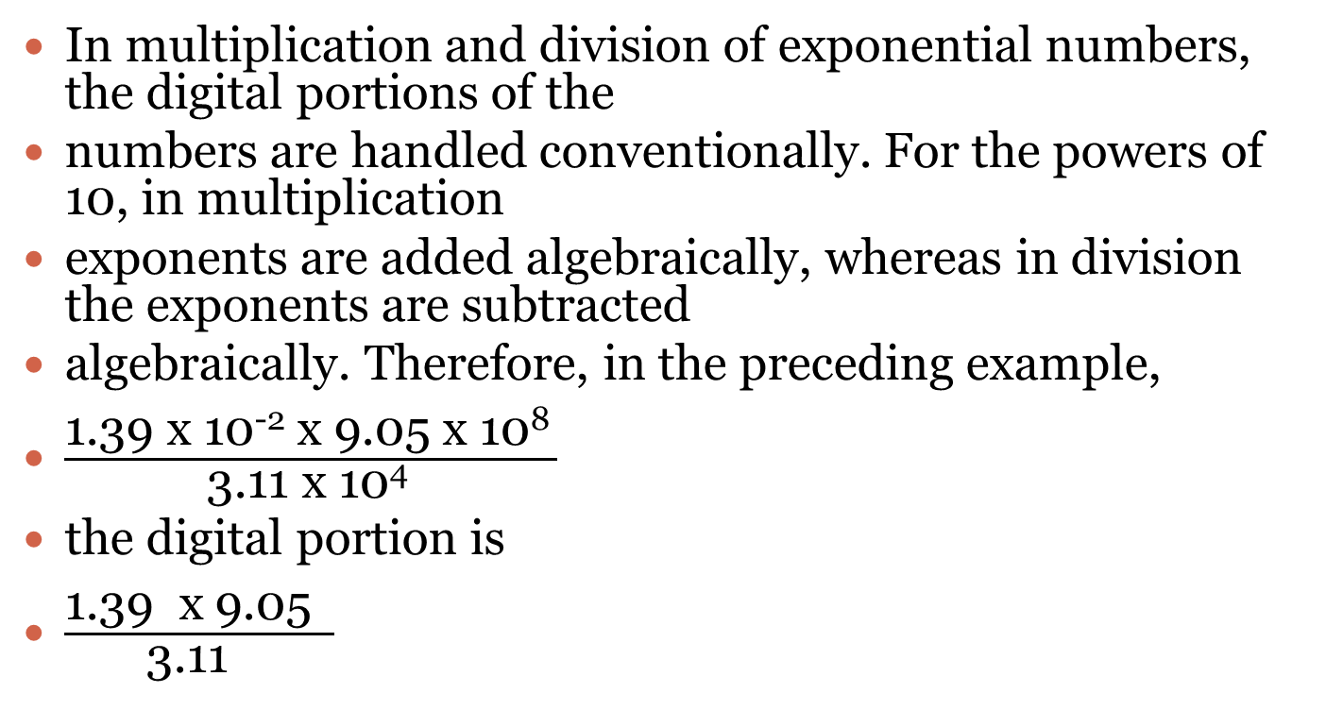
.
In multiplication and division of exponential numbers, the digital portions of the
numbers are handled conventionally. For the powers of 10, in multiplication
exponents are added algebraically, whereas in division the exponents are subtracted
algebraically. Therefore, in the preceding example,
$\frac{\text{1.39 }\text{x}\text{ 10−2 }\text{x}\text{ 9.05 }\text{x}\text{ 108 }}{\text{3.11 }\text{x}\text{ 104 }}$
the digital portion is
$\frac{\text{1.39 }\text{x}\text{ 9.05 }}{\text{3.11 }}$

Slide 38

.
and the exponential portion is,
$\frac{\text{10}\text{−2 } \text{x}\text{ 108 }}{\text{10}\text{4 }}$=10² (The exponent is -2+8-4)
So the answer is 4.04 x102.

Slide 39
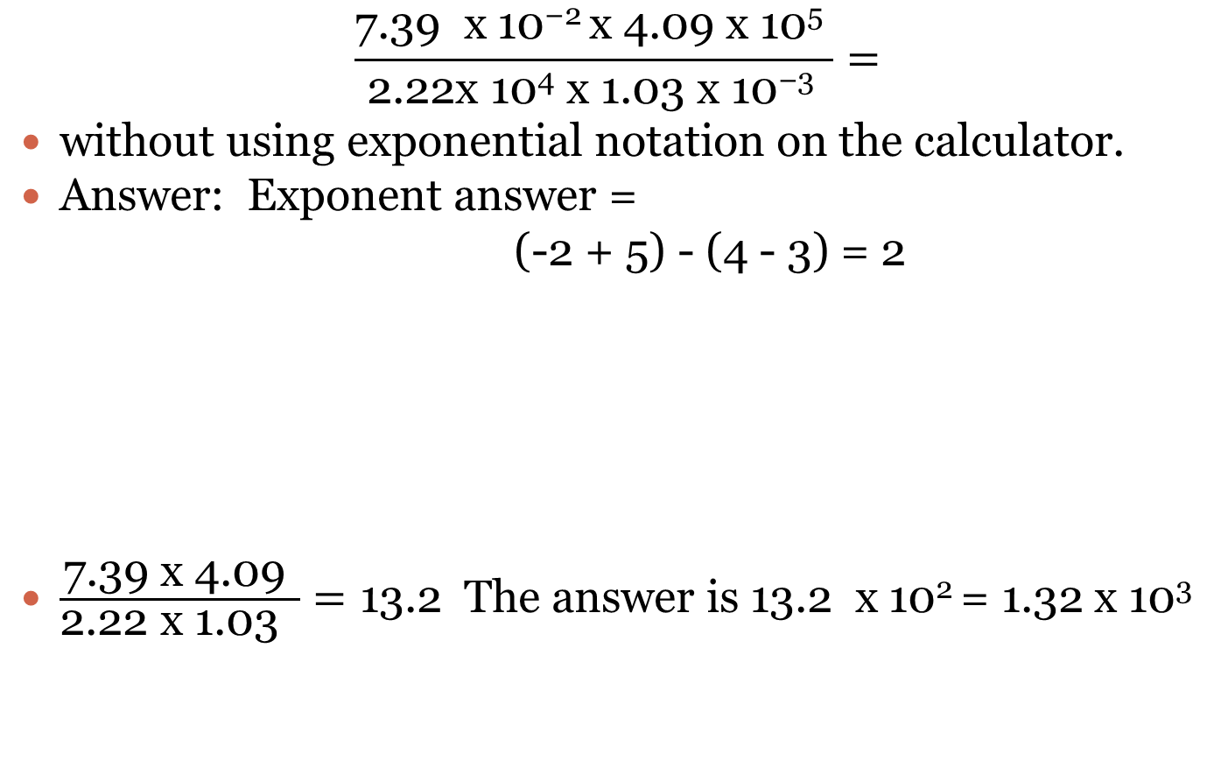
Example: Solve
$$\frac{\text{7.39 }\text{x}\text{ 10−2 }\text{x}\text{ 4.09 }\text{x}\text{ 105 }}{\text{2.22}\text{x}\text{ 104 }\text{x}\text{ 1.03 }\text{x}\text{ 10−3 }}=$$
without using exponential notation on the calculator.
Answer: Exponent answer =
(-2 + 5) - (4 - 3) = 2
$\frac{\text{7.39 }\text{x}\text{ 4.09 }}{\text{2.22} \text{x}\text{ 1.03 }}=\text{13.2}$ The answer is 13.2 x 10² = 1.32 x 10³
Algebraic addition of
exponents in the numerator
Algebraic subtraction of exponents in the denominator

Slide 40

.
Example: Solve
$$\frac{\text{3.49 }\text{x}\text{ 103 }}{\text{3.26 }\text{x}\text{ 1018 }\text{x}\text{ 7.47 }\text{x}\text{ 10−5 }\text{x}\text{ 6.18 }\text{x}\text{ 10−8 }}=$$
Answer: 2.32 x 10⁻⁴

Slide 41
SIGNIFICANT FIGURES AND UNCERTAINTIES IN NUMBERS
The preceding section illustrated how to handle very large and very small numbers with exponential notation.
This section considers uncertainties in numbers, taking into account the fact that numbers are known only to a certain degree of accuracy.
The accuracy of a number is shown by how many significant figures or significant digits it contains.
This can be illustrated by considering the atomic masses of elemental boron and sodium.
The atomic mass of boron is given as 10.81. Written in this way, the number expressing the atomic mass of boron contains four significant digits—the 1, the 0, the 8, and the l. It is understood to have an uncertainty
of + or - 1 in the last digit, meaning that it is really 10.81±0.01.

Slide 42
.
The atomic mass of sodium is given as 22.98977, a number with seven significant digits understood to mean 22.98977±0.00001. Therefore, the atomic mass of sodium is known with more certainty than that of boron.
The atomic masses in Table 1.1 reflect the fact that they are known with much more certainty for some elements (for example fluorine, 18.998403) than for others (for example, calcium listed with an atomic mass of 40.08).
The rules for expressing significant digits are summarized in Table 1.3. It is important to express numbers to the correct number of significant digits in chemical calculations and in the laboratory.
The use of too many digits implies an accuracy in the number that does not exist and is misleading.
The use of too few significant digits does not express the number to the degree of accuracy to which it is known.

Slide 43
.
Table 1.3 Rules for Use of Significant Digits
Example Number | No of sig digits | Rule
11.397 | 5 | 1. Non-zero digits in a number are always significant. The 1,1,3,9, and 7 in this number are each significant.
140.039 | 6 | 2. Zeros between non-zero digits are significant. The 1, 4, 0, 0, 3, and 9 in this number are each significant.
0.000329 | 3 | 3. Zeros on the left of the first non-zero digit are not significant because they are used only to locate the decimal point. Only 3, 2, and 9 in this number are significant.
70.00 | 4 | 4. Zeros to the right of a decimal point that are preceded by a significant figure are significant. All three 0s, as well as the 7, are significant.

Slide 44
.
Table 1.3 Rules for Use of Significant Digits
Example Number | No of sig digits | Rule
32000 | Uncertain | 5. The number of significant digits in a number with zeros to the left, but not to the right of a decimal point (1700, 110 000) may be uncertain. Such numbers should be written in exponential notation.
3.20 x 10³ | 3 | 6. The number of significant digits in a number written in exponential notation is equal to the number of significant digits in the decimal portion.
Exact 50 | Unlimited | 7. Some numbers, such as the amount of money that one expects to receive when cashing a check or the number of children claimed for income tax exemptions, are defined as exact numbers without any uncertainty.

Slide 45
Exercise:
Referring to Table 1.3, give the number of significant digits and the rule(s)
upon which they are based for each of the following numbers:
(a) 17.000 (b) 9.5378 (c) 7.001
(d) $50 (e) 0.00300 (f) 7400
(g) 6.207 x 10⁻⁷ (h) 13.5269184 (i) 0.05029

Slide 46
Answers:
(a) 5, Rule 4; (b) 5, Rule 1; (c) 4, Rule 2;
(d) exact number; (e) 3, Rules 3 and 4; (f) uncertain, Rule 5;
(g) 4, Rule 6; (h) 9, Rule 1; (i) 4 Rules 2 and 3

Slide 47
Significant Figures in Calculations
After numbers are obtained by a laboratory measurement, they are normally subjected to mathematical operations to get the desired final result.
It is important that the answer have the correct number of significant figures.
It should NOT have so few that accuracy is sacrificed or so many that an unjustified degree of accuracy is implied.
The two major rules that apply, one for addition
/subtraction, the other for multiplication /division, are the following:

Slide 48
In addition and subtraction of Sig figures.
1. In addition and subtraction, the number of digits retained to the right of
the decimal point should be the same as that in the number in the calculation with the fewest such digits.
Example: 273.591 + 1.00327 + 229.13 = 503.72427 is rounded to 503.72 because 229.13 has only two significant digits beyond the decimal.
Example: 313.4 + 11.0785 + 229.13 = 553.6085 is rounded to 553.6 because 313.4 has only one significant digit beyond the decimal.

Slide 49
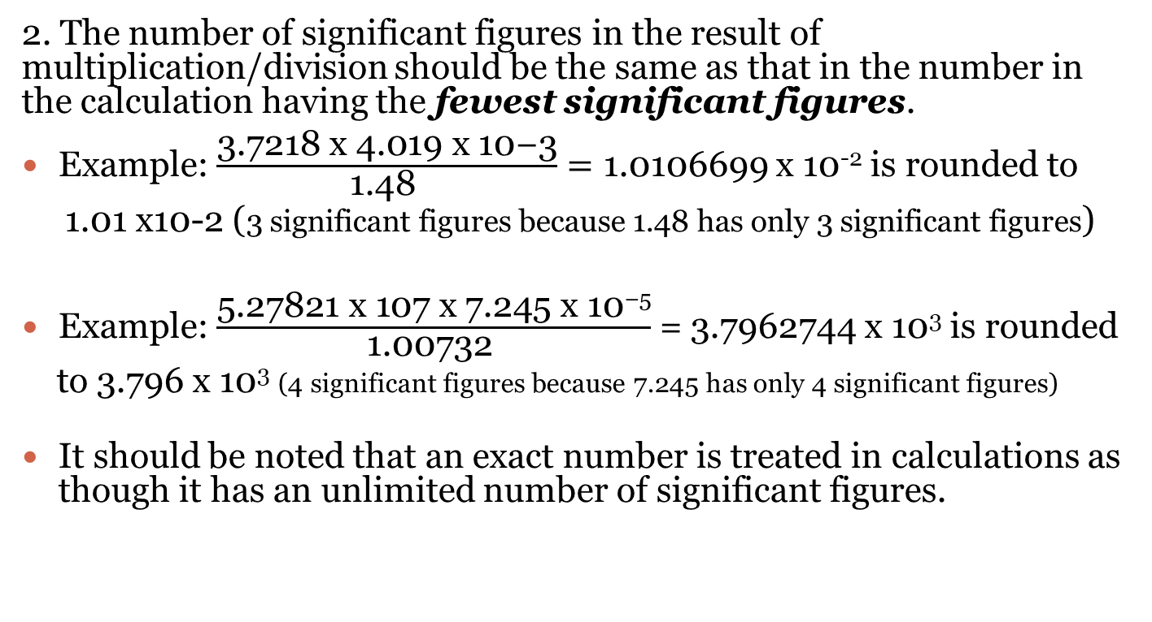
Multiplication/Division
2. The number of significant figures in the result of multiplication/division should be the same as that in the number in the calculation having the fewest significant figures.
Example: $\frac{\text{3.7218 }\text{x}\text{ 4.019 }\text{x}\text{ 10−3}}{\text{1.48 }}=$ 1.0106699 x 10⁻² is rounded to
1.01 x10-2 (3 significant figures because 1.48 has only 3 significant figures)
Example: $\frac{\text{5.27821 }\text{x}\text{ 107 }\text{x}\text{ 7.245 }\text{x}\text{ 10}\text{−5}}{\text{1.00732 }}$= 3.7962744 x 10³ is rounded
to 3.796 x 10³ (4 significant figures because 7.245 has only 4 significant figures)
It should be noted that an exact number is treated in calculations as though it has an unlimited number of significant figures.

Slide 50
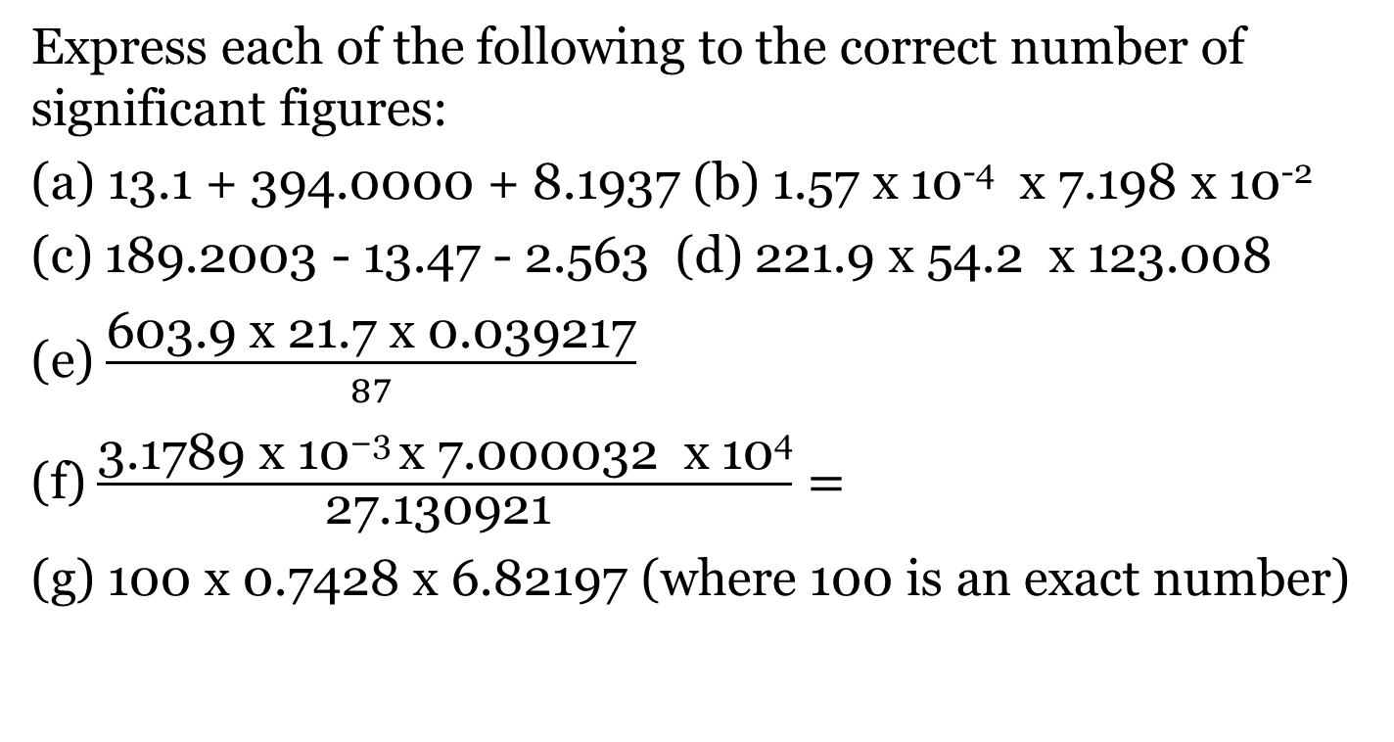
Exercise
Express each of the following to the correct number of significant figures:
(a) 13.1 + 394.0000 + 8.1937 (b) 1.57 x 10⁻⁴ x 7.198 x 10⁻²
(c) 189.2003 - 13.47 - 2.563 (d) 221.9 x 54.2 x 123.008
(e) $\frac{\text{603.9 }\text{x}\text{ 21.7 }\text{x}\text{ 0.039217}}{87}$
(f) $\frac{\text{3.1789 }\text{x}\text{ 10−3 }\text{x}\text{ 7.000032 }\text{x}\text{ 104}}{\text{27.130921 }}=$
(g) 100 x 0.7428 x 6.82197 (where 100 is an exact number)

Slide 51
Answers:
(a) 415.3, (b) 1.13 x 10⁻⁵, (c) 173.17, (d) 1.48 x 10⁶, (e) 5.9,
(f) 8.2019, (g) 506.7

Slide 52
Rounding Numbers
With an electronic calculator it is easy to obtain a long string of digits that must be rounded to the correct number of significant figures.
The rules for doing this are the following:
1. If the digit to be dropped is 0, 1, 2, 3, or 4, leave the last digit unchanged
Example: Round 4.17821 to 4 significant digits
Answer: 4.178
Last retained digit is 8. 2 is the digit to be dropped
2. If the digit to be dropped is 5,6,7,8 or 9, increase the last retained digit by 1
Example: Round 4.17821 to 3 significant digits
Answer: 4.18
Last retained digit is 7. Digit to be dropped is 8, so increase 7 by 1

Slide 53
Use of Three Significant Digits
It is possible to become thoroughly confused about how many significant figures to retain in an answer.
In such a case it is often permissible to use 3 significant figures.
Generally, this gives sufficient accuracy without doing grievous harm to the concept of significant figures.

Slide 54
MEASUREMENTS AND SYSTEMS OF MEASUREMENT
The development of chemistry has depended strongly upon careful measurements.
Historically, measurements of the quantities of substances reacting and produced in chemical reactions have allowed the explanation of the fundamental nature of chemistry.
Exact measurements continue to be of the utmost importance in chemistry and are facilitated by increasing sophisticated instrumentation.
For example, atmospheric chemists can determine a small degree of stratospheric ozone depletion by measuring minute amounts of ultraviolet radiation absorbed by ozone with satellite-mounted instruments.
Determinations of a part per trillion or less of a toxic substance in water may serve to trace the source of a hazardous pollutant.
This section discusses the basic measurements commonly made in chemistry and environmental chemistry.

Slide 55
SI Units of Measurement
Several systems of measurement are used in chemistry and environmental chemistry.
The most systematic of these is the International System of Units, abbreviated SI, a self-consistent set of units based upon the metric system recommended in 1960 by the General Conference of Weights and Measures to simplify and make more logical the many units used in the scientific and engineering community.
Table 1.4 gives the seven base SI units from which all others are derived.

Slide 56
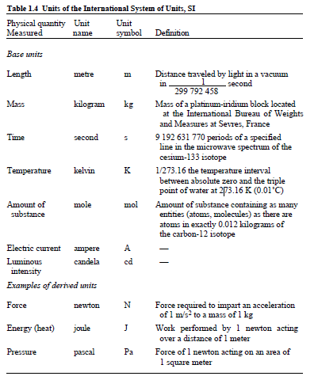

Slide 57
Multiples of Units
Quantities expressed in science often range over many orders of magnitude (many factors of 10).
For example, a mole of molecular diatomic nitrogen contains 6.02 x 10²³ .
N2 molecules and very small particles in the atmosphere may be only about 1 x 10⁻⁶ meters in diameter.
It is convenient to express very large or very small multiples by means of prefixes that give the number of times that the basic unit is multiplied.
Each prefix has a name and an abbreviation.
The ones that are used in this lesson, or that are most commonly encountered, are given in Table 1.5.

Slide 58
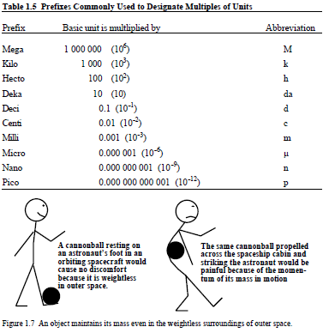
.

Slide 59
Metric and English Systems of Measurement
The metric system has long been the standard system for scientific measurement
and is the one most commonly used in this session.
It was the first to use multiples of 10 to designate units that differ by orders of magnitude from a basic unit.
The English system is still employed for many measurements encountered in normal everyday activities in the United States, including some environmental engineering measurements.
Bathroom scales are still calibrated in pounds, well depths may be given in feet, and quantities of liquid wastes are frequently expressed as gallons or barrels.
Furthermore, English units of pounds, tons, and gallons are still commonly used in commerce, even in the chemical industry.
Therefore, it is still necessary to have some familiarity with this system; conversion factors between it and metric units are given in this lesson.

Slide 60
UNITS OF MASS
Mass expresses the degree to which an object resists a change in its state of rest or motion and is proportional to the amount of matter in the object.
Weight is the gravitational force acting upon an object and is proportional to mass.
An object weighs much less in the gravitational force on the Moon’s surface than on Earth, but the object’s mass is the same in both places (Figure 1.7).
Although mass and weight are not usually distinguished from each other in everyday activities, it is important for the science student to be aware of the differences between them.

Slide 61
Mass Units
The gram (g) with a mass equal to 1/1000 that of the SI kilogram (see Table 1.4) is the fundamental unit of mass in the metric system. Although the gram is a convenient unit for many laboratory-scale operations, other units that are multiples of the gram are often more useful for expressing mass. The names of these are obtained by affixing the appropriate prefixes from Table 1.5 to “gram.”
Global burdens of atmospheric pollutants may be given in units of teragrams, each equal to 1 x 10¹² grams.
Significant quantities of toxic water pollutants may be measured in micrograms (1 x 10⁻⁶ grams).
Large-scale industrial chemicals are marketed in units of megagrams (Mg).
This quantity is also known as a metric ton, or tonne, and is somewhat larger
(2205 lb) than the 2000-lb short ton still used in commerce in the United States.
Table 1.6 summarizes some of the more commonly used metric units of mass and their relationship to some English units.

Slide 62
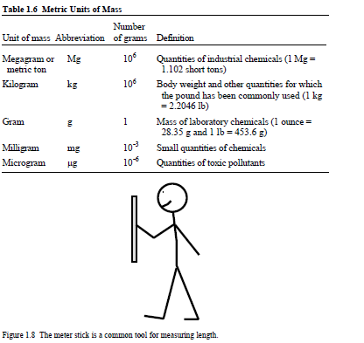
.

Slide 63
1.10 UNITS OF LENGTH
Length in the metric system is expressed in units based upon the meter, m (SI spelling metre, Table 1.4).
A meter is 39.37 inches long, slightly longer than a yard.
A kilometer (km) is equal to 1000 m and, like the mile, is used to measure relatively
great distances.
A centimeter (cm), equal to 0.01 m, is often convenient to designate lengths such as the dimensions of laboratory instruments.
There are 2.540 cm per inch, and the cm is employed to express lengths that would be given in inches in the English system.
The micrometer (μm) is about as long as a typical bacterial cell.
The μm is also used to express wavelengths of infrared radiation by which Earth reradiates solar energy back to outer space.
The nanometer (nm), equal to 10⁻⁹ m, is a convenient unit for the wavelength of visible light, which ranges from 400 to 800 nm.
Atoms are even smaller than 1 nm; their dimensions are commonly given in picometers (pm, 10⁻¹² m).
Table 1.7 lists common metric units of length, some examples of their use, and some related English units.

Slide 64
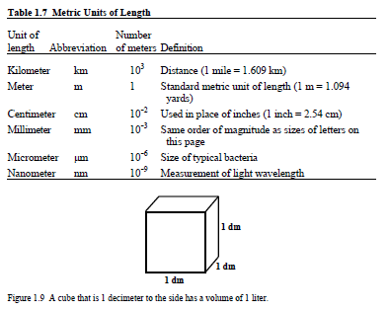

Slide 65
UNITS OF VOLUME
The basic metric unit of volume is the liter, which is defined in terms of metric units of length.
As shown in Figure 1.9, a liter is the volume of a decimeter cubed, that is, 1 L = 1 dm³ (a dm is 0.1 meter, about 4 inches).
A milliliter (mL) is the same volume as a centimeter cubed (cm³ or cc), and a liter is 1000 cm³.
A kiloliter, usually designated as a cubic meter (m³), is a common unit of measurement for the volume of air.
For example, standards for human exposure to toxic substances in the workplace are frequently given in units of μg/m³.
Table 1.8 gives some common metric units of volume.
The measurement of volume is one of the more frequently performed routine laboratory measurements; Figure 1.10 shows some of the more common tools for laboratory volume measurement of liquids.

Slide 66
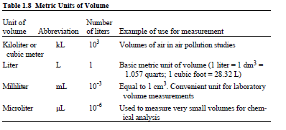
.

Slide 67
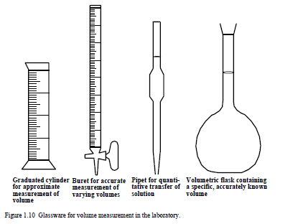
.
,

Slide 68
TEMPERATURE, HEAT, AND ENERGY
Temperature Scales
In chemistry, temperatures are usually expressed in metric units of Celsius degrees, °C, in which water freezes at 0°C and boils at 100°C.
The Fahrenheit scale, still used for some non-scientific temperature measurements in the U.S., defines the freezing temperature of water at 32 degrees Fahrenheit (°F) and boiling at 212°F, a range of 180°F.
Therefore, each span of 100 Celsius degrees is equivalent to one of 180 Fahrenheit degrees and each °C is equivalent to 1.8°F.

Slide 69
.
The most fundamental temperature scale is the Kelvin or absolute scale, for which zero is the lowest attainable temperature.
A unit of temperature on this scale is equal to a Celsius degree, but it is called a kelvin, abbreviated K, not a degree.
Kelvin temperatures are designated as K, not °K. The value of absolute zero on the Kelvin scale is -273.15°C, so that the Kelvin temperature is always a number 273.15 (usually
rounded to 273) higher than the Celsius temperataure.
Thus water boils at 373 K and freezes at 273 K. The relationships among Kelvin, Celsius, and Fahrenheit temperatures are illustrated in Figure 1.11.

Slide 70
Converting from Fahrenheit to Celsius
With Figure 1.11 in mind, it is easy to convert from one temperature scale to another.
Examples of how this is done are given below:
Example: What is the Celsius temperature equivalent to room temperature of 70°F?
Answer:
Step 1. Subtract 32 Fahrenheit degrees from 70 Fahrenheit degrees to get the number of Fahrenheit degrees above freezing.
This is done because 0 on the Celsius scale is at the freezing point of water.

Slide 71
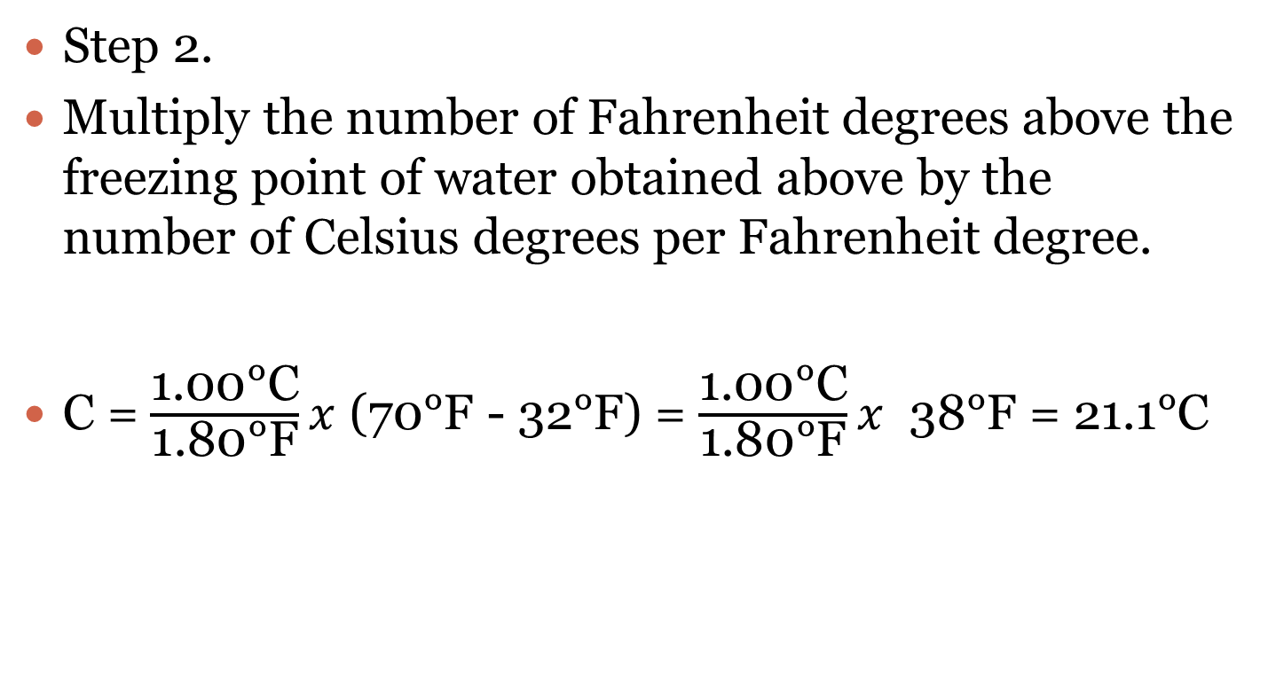
Step 2.
Multiply the number of Fahrenheit degrees above the freezing point of water obtained above by the number of Celsius degrees per Fahrenheit degree.
C = $\frac{\text{1.00°}\text{C}}{\text{1.80°}\text{F}}x$ (70°F - 32°F) = $\frac{\text{1.00°}\text{C}}{\text{1.80°}\text{F}}x$ 38°F = 21.1°C

Slide 72
.
In working the above example it is first noted (as is obvious from Figure 1.11) that the freezing temperature of water, zero on the Celsius scale, corresponds to 32°F on the Fahrenheit scale.
So 32°F is subtracted from 70°F to give the number of Fahrenheit degrees by which the temperature is above the freezing point of water.
The number of Fahrenheit degrees above freezing is converted to Celsius degrees above the freezing point of water by multiplying by the factor 1.00°C/1.80°F.

Slide 73
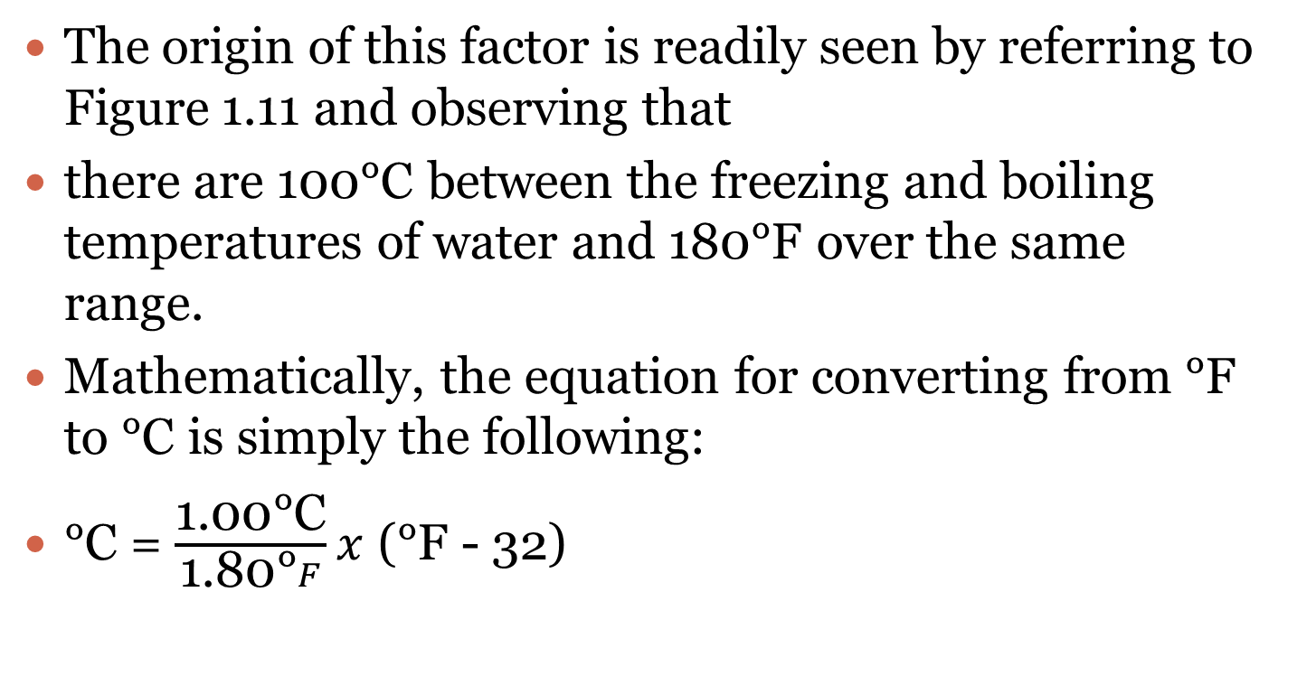
.
The origin of this factor is readily seen by referring to Figure 1.11 and observing that
there are 100°C between the freezing and boiling temperatures of water and 180°F over the same range.
Mathematically, the equation for converting from °F to °C is simply the following:
°C = $\frac{\text{1.00°}\text{C}}{\text{1.}\text{80}\text{°}F}x$ (°F - 32)

Slide 74
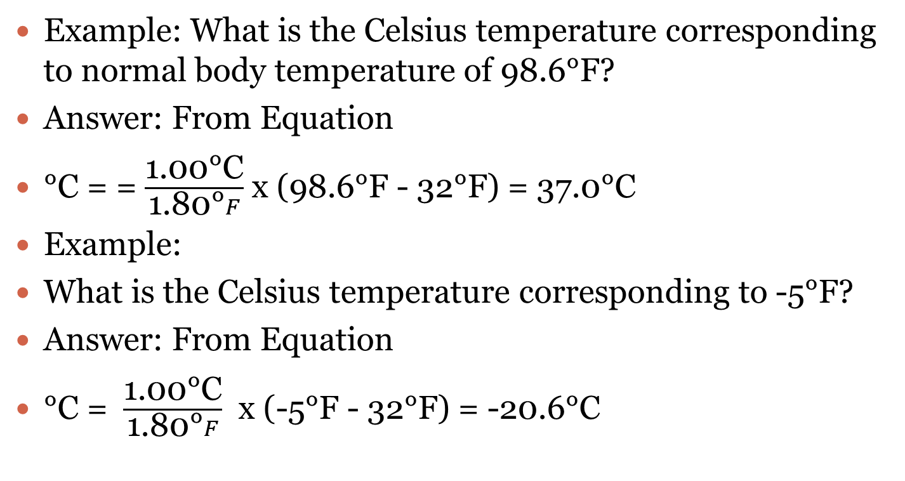
EG.
Example: What is the Celsius temperature corresponding to normal body temperature of 98.6°F?
Answer: From Equation
°C = = $\frac{\text{1.00°}\text{C}}{\text{1.80°}F}$ x (98.6°F - 32°F) = 37.0°C
Example:
What is the Celsius temperature corresponding to -5°F?
Answer: From Equation
°C = $\frac{\text{1.00°}\text{C}}{\text{1.80°}F}$ x (-5°F - 32°F) = -20.6°C

Slide 75
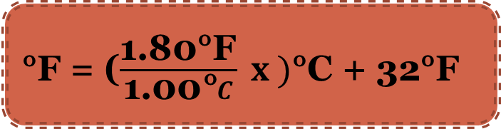
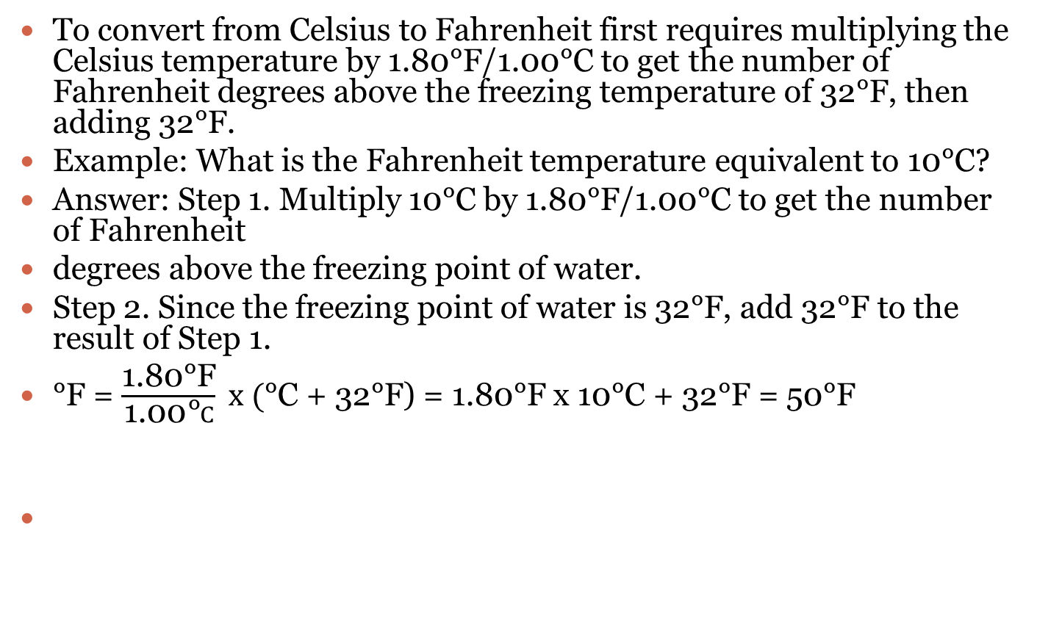
Converting from Celsius to Fahrenheit
To convert from Celsius to Fahrenheit first requires multiplying the Celsius temperature by 1.80°F/1.00°C to get the number of Fahrenheit degrees above the freezing temperature of 32°F, then adding 32°F.
Example: What is the Fahrenheit temperature equivalent to 10°C?
Answer: Step 1. Multiply 10°C by 1.80°F/1.00°C to get the number of Fahrenheit
degrees above the freezing point of water.
Step 2. Since the freezing point of water is 32°F, add 32°F to the result of Step 1.
°F = $\frac{\text{1.80°}\text{F}}{\text{1}\text{.00}\text{°}C} x ($°C + 32°F) = 1.80°F x 10°C + 32°F = 50°F
°F = ($\frac{\text{1.80°}\text{F}}{\text{1}\text{.}\text{00}\text{°}C} x )$°C + 32°F

Slide 76
Converting Celcius to Kelvin
To convert from °C to K, add 273 to the Celsius temperature.
To convert from K to °C, subtract 273 from K.
All of the conversions discussed here can be deduced without memorizing any equations by remembering that the freezing point of water is 0°C, 273 K, and 32°F, whereas the boiling point is 100°C, 373 K, and 212°F.

Slide 77
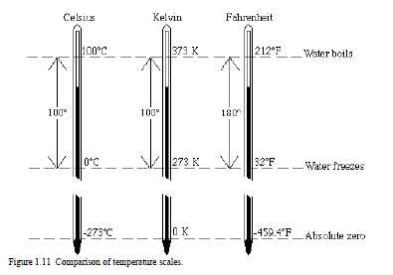
Comparison of Temp Scales
.

Slide 78
Melting Point and Boiling Point
These are important thermal properties of any substance.
For the present, melting temperature may be defined as the temperature at which a substance changes from a solid to a liquid.
Boiling temperature is defined as the temperature at which a substance changes from a liquid to a gas.
More exacting definitions of these terms, particularly boiling temperature, are given later in the lesson.

Slide 79
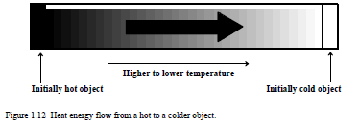
Heat and Energy
As illustrated in Figure below, when two objects at different temperatures are placed in contact with each other, the warmer object becomes cooler and the cooler one warmer until they reach the same temperature.
This occurs because of a flow of energy between the objects. Such a flow is called heat.

Slide 80
SI Unit for Energy
The SI unit of heat is the joule (J, see Table below).
The kilojoule (1 kJ = 1000 J) is a convenient unit to use to express energy values in laboratory studies.
The metric unit of energy is the calorie (cal), equal to 4.184 J.
Throughout the liquid range of water, essentially 1 calorie of heat energy is required to raise the temperature of 1 g of water by 1°C.
The “calories” most people hear about are those used to express energy values of foods and are actually kilocalories (1 kcal = 4.184 kJ).

Slide 81
1.13 PRESSURE
Pressure is force per unit area. The SI unit of pressure is the pascal (Pa), defined in Table 1.4.
The kilopascal (1 kPa = 1000 Pa) is often a more convenient unit of pressure to use than is the pascal.
Like many other quantities, pressure has been plagued with a large number of different kinds of units.
One of the more meaningful and intuitive of these is the atmosphere (atm), and the average pressure exerted by air at sea level is 1 atmosphere.
One atmosphere is equal to 101.3 kPa or 14.7 lb/in2.
The latter means that an evacuated cube, 1 inch to the side, has a force of 14.70 lb exerted on each side due to atmospheric pressure.
It is also the pressure that will hold up a column of liquid mercury metal 760 mm long, as shown in Figure 1.13.

Slide 82
.
Such a device used to measure atmospheric pressure is called a barometer, and the mercury barometer was the first instrument used to measure pressures with a high degree of accuracy.
Consequently, the practice developed of expressing pressure in units of millimeters of mercury (mm Hg), where 1 mm of mercury is a unit called the torr.
Pressure is an especially important variable with gases because the volume of a quantity of gas at a fixed temperature is inversely proportional to pressure.
The temperature/pressure/volume relationships of gases (Boyle’s law, Charles’ law, general gas law) are discussed in Chapter 2.

Slide 83
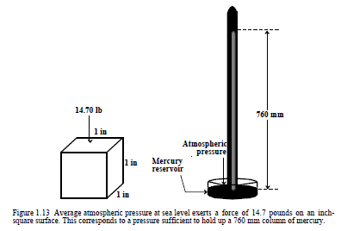
Table 1.13

Slide 84
1.14 UNITS AND THEIR USE IN CALCULATIONS
Most numbers used in chemistry are accompanied by a unit that tells the type of quantity that the number expresses and the smallest whole portion of that quantity.
For example, “36 liters” denotes that a volume is expressed and the smallest whole unit of the volume is 1 liter.
The same quantity could be expressed as 360 deciliters, where the number is multiplied by 10 because the unit is only 1/10 as large.
Except in cases where the numbers express relative quantities, such as atomic masses relative to the mass of carbon-12 or specific gravity, it is essential to include units with numbers.
In addition to correctly identifying the type and magnitude of the quantity expressed, the units are carried through mathematical operations.
The wrong unit in the answer shows that something has been done wrong in the calculation and it must be checked.

Slide 85
Unit Conversion Factors
Most chemical calculations involve calculating one type of quantity, given another, or converting from one unit of measurement to another.
For example, in the chemical reaction
2H₂ + O₂ → H₂O
someone might want to calculate the number of grams of H₂O produced when 3 g of H₂ react, or they might want to convert the number of grams of H₂ to ounces.
These kinds of calculations are carried out with unit conversion factors.

Slide 86
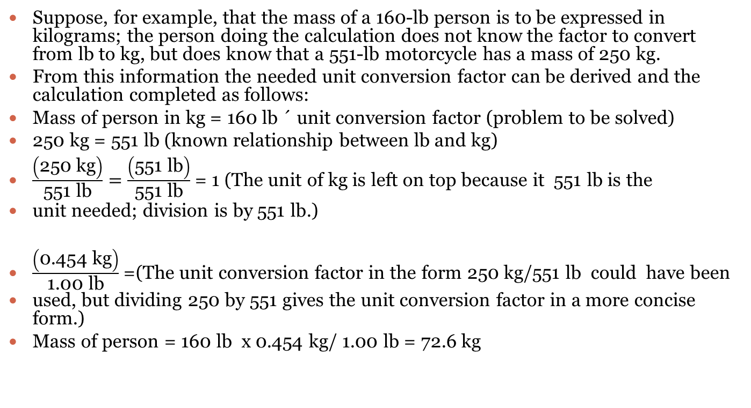
Kgs to lbs
Suppose, for example, that the mass of a 160-lb person is to be expressed in kilograms; the person doing the calculation does not know the factor to convert from lb to kg, but does know that a 551-lb motorcycle has a mass of 250 kg.
From this information the needed unit conversion factor can be derived and the calculation completed as follows:
Mass of person in kg = 160 lb ´ unit conversion factor (problem to be solved)
250 kg = 551 lb (known relationship between lb and kg)
$\frac{\left(\text{250 }\text{kg}\right)}{\text{551 }\text{lb}}=\frac{\left(\text{551 }\text{lb}\right)}{\text{551 }\text{lb}}$= 1 (The unit of kg is left on top because it 551 lb is the
unit needed; division is by 551 lb.)
$\frac{\left(\text{0.454 }\text{kg}\right)}{\text{1.00 }\text{lb}}$=(The unit conversion factor in the form 250 kg/551 lb could have been
used, but dividing 250 by 551 gives the unit conversion factor in a more concise form.)
Mass of person = 160 lb x 0.454 kg/ 1.00 lb = 72.6 kg

Slide 87
.
It is permissible to multiply 160 lb by 0.454 kg/1.00 lb because, as shown by Equation this unit conversion factor has a value of exactly 1.
Any quantity can be multiplied by 1 without changing the quantity itself; the only change is in the units in which it is expressed.

Slide 88
LITERS, GALLONS & QUARTS
As another example of the use of a unit conversion factor, calculate the number of liters of gasoline required to fill a 12-gallon fuel tank, given that there are 4 quarts in a gallon and that a volume of 1 liter is equal to that of 1.057 quarts.
This problem can be worked by first converting gallons to quarts, then quarts to liters.
For the first step, the unit conversion factor is

Slide 89
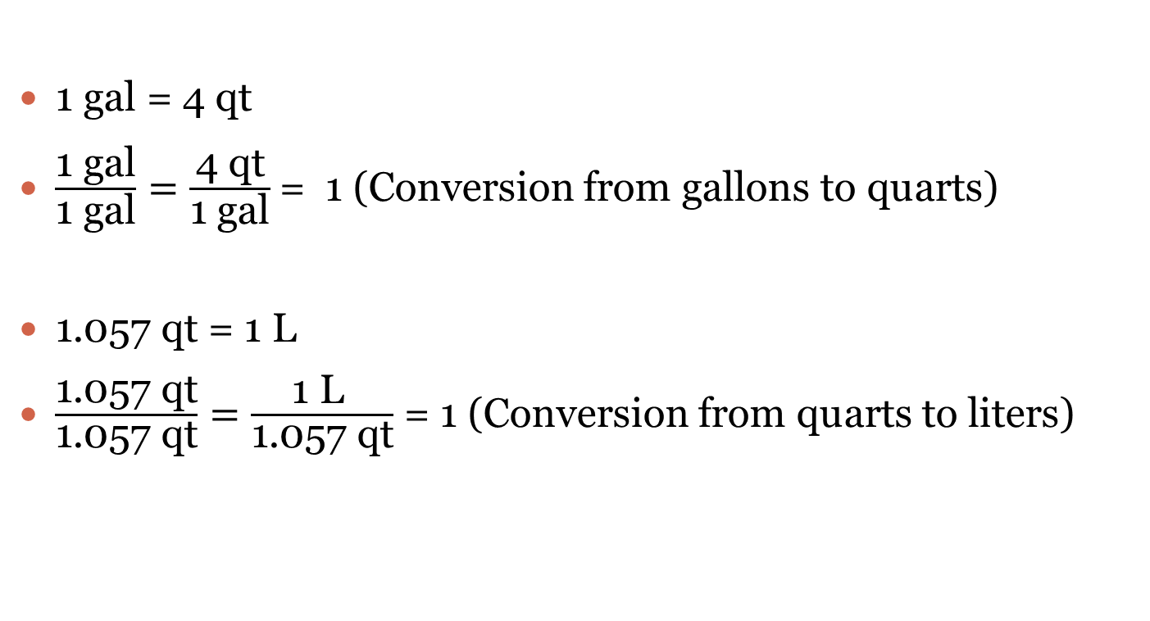
.
1 gal = 4 qt
$\frac{\text{1 }\text{gal}}{\text{1 }\text{gal}}=\frac{\text{4 }\text{qt}}{\text{1 }\text{gal}}$= 1 (Conversion from gallons to quarts)
1.057 qt = 1 L
$\frac{\text{1.057 }\text{qt}}{\text{1.057 }\text{qt}}=\frac{\text{1 }\text{L} }{\text{1.057 }\text{qt}}$ = 1 (Conversion from quarts to liters)

Slide 90
.
Both unit conversion factors are used to calculate the capacity of the tank in liters:
Tank capacity =
12 gal x 4 qt / 1 L x 1 gal /1.057 qt = 45.4 L

Slide 91
Cancellation of Units
The preceding examples show that units are canceled in mathematical operations, just as numbers may be.
When the same unit appears both above and below the line in a mathematical operation, the units cancel.
An example of such an operation is shown for lb in the following:
160 lb x 0.454 kg/1.00 lb
The unit of lb simply cancels, leaving kg as the unit remaining.

Slide 92
Calculation of Some Unit Conversion Factors
Several values of units are given that enable conversion between metric and English units in Table 1.6 (mass), Table 1.7 (length), and Table 1.8 (volume).
For example, Table 1.6 states that a megagram (Mg, metric ton) is equal to 1.102 short tons (T).
By using this equality to give the correct unit conversion factors, it is easy to calculate the number of metric tons in a given number of short tons of material or vice versa.
To do this, first write the known equality given that a megagram is equal to 1.102 short tons:
1 Mg = 1.102 T

Slide 93
Mg toTonnes
If the number of Mg is to be calculated given a mass in T, the unit conversion factor needed is leaving Mg on top.
1 Mg/ 1.102 T = 1.102 T/ 1.102 T = 1
Suppose, for example, that the problem is to calculate the mass in Mg of a 3521 T shipment of industrial soda ash.
The calculation involves simply multiplying the known mass in T times the unit conversion factor required to convert to Mg:
3521 T x 1 Mg / 1.102 T = 3195 Mg

Slide 94
Tonnes to Mg
If the problem had been to calculate the number of T in 789 Mg of copper ore, the following steps would be followed:
1.102 T = 1 Mg, 1.102 T/ 1 Mg = 1 Mg/ 1 Mg = 1,
789 Mg x 1.102 T/ 1 Mg = 869 T copper ore

Slide 95
.
Table 1.9 gives some unit conversion factors calculated from the information given in Tables 1.6–1.8 and in preceding parts of this chapter.
Note that in each case, two unit conversion factors are calculated; the one that is used depends upon the units that are required for the answer.

Slide 96
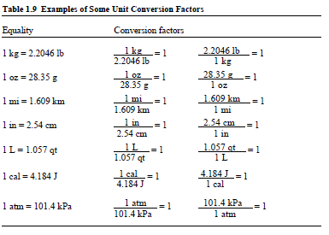
.

Slide 97
,
☺
OK DONE

